Slide 1
[ Network Embedding ]
Multi-Label Classification Project : classification model ( Logistic Regression/OVR, MLP )
Seunghan Lee (CSE-URP) 20.01.22(Wed)

Slide 2
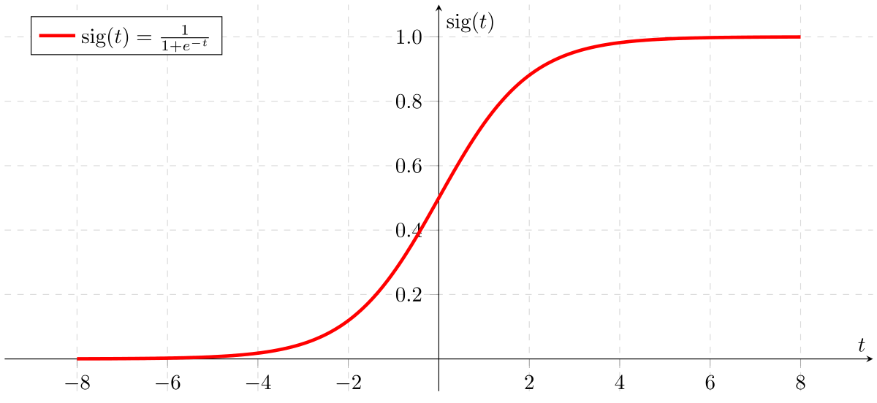
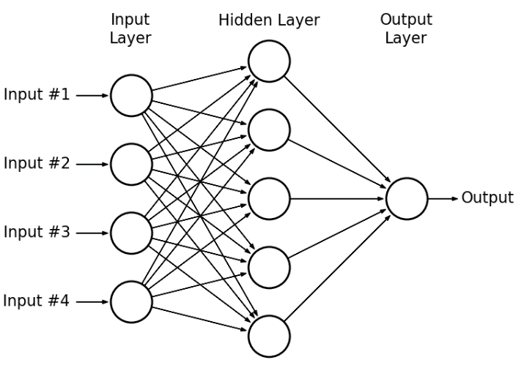
Goal
1) Implement classification model using Logistic Regression / OVR & MLP
2) Evaluate with various metrics ( precision, recall, accuarcy, F1-score )
Logistic Regression
Multi Layer Perceptron
https://miro.medium.com/max/2400/1*RqXFpiNGwdiKBWyLJc_E7g.png
https://www.researchgate.net/profile/Mohamed_Zahran6/publication/303875065/figure/fig4/AS:371118507610123@14654
92955561/A-hypothetical-example-of-Multilayer-Perceptron-Network.png

Slide 3
Contents
1
Introduction
Brief overview of Algorithm ( Logistic Regression / OVR & MLP )
2
Implementation
Karate ( Logistic Regression & MLP )
Other datasets ( OVR )

Slide 4
1. Introduction
Brief overview of Logistic Regression / OVR& MLP

Slide 5
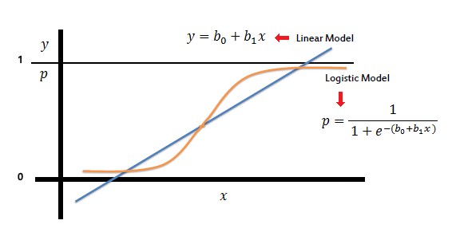
1. Introduction
1. Logistic Regression
Regression (X) Classification (O)
Sigmoid Function ( output value : 0 ~ 1 )
used as a “binary” classifier
http://juangabrielgomila.com/wp-content/uploads/2015/04/LogReg_1.png
Find the best b0, b1
that best fits the data!

Slide 6
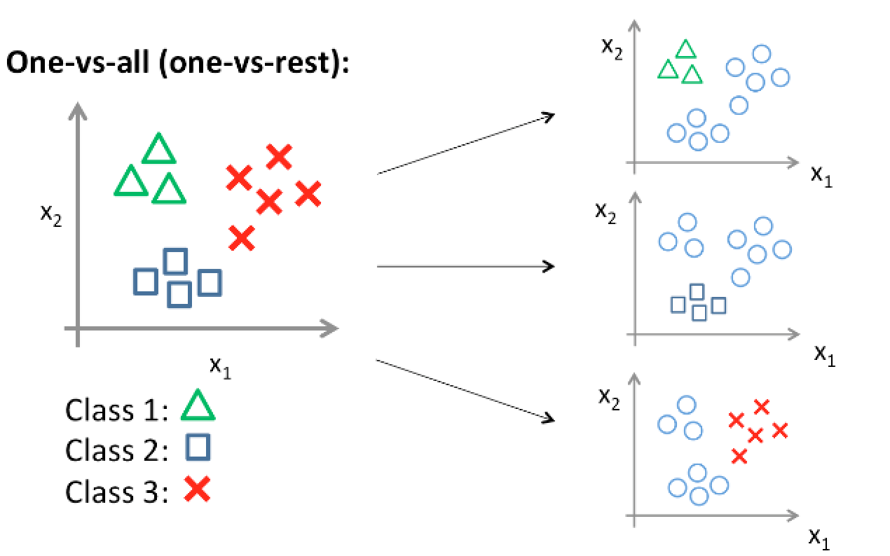
1. Introduction
OVR ( One-Versus-Rest )
used in MULTI CLASS Classification
compare ONE group with all the REST ( rest : treat the others as same one group )
need “C” Classifiers ( C : unique number of classes )
https://houxianxu.github.io/images/logisticRegression/4.png

Slide 7
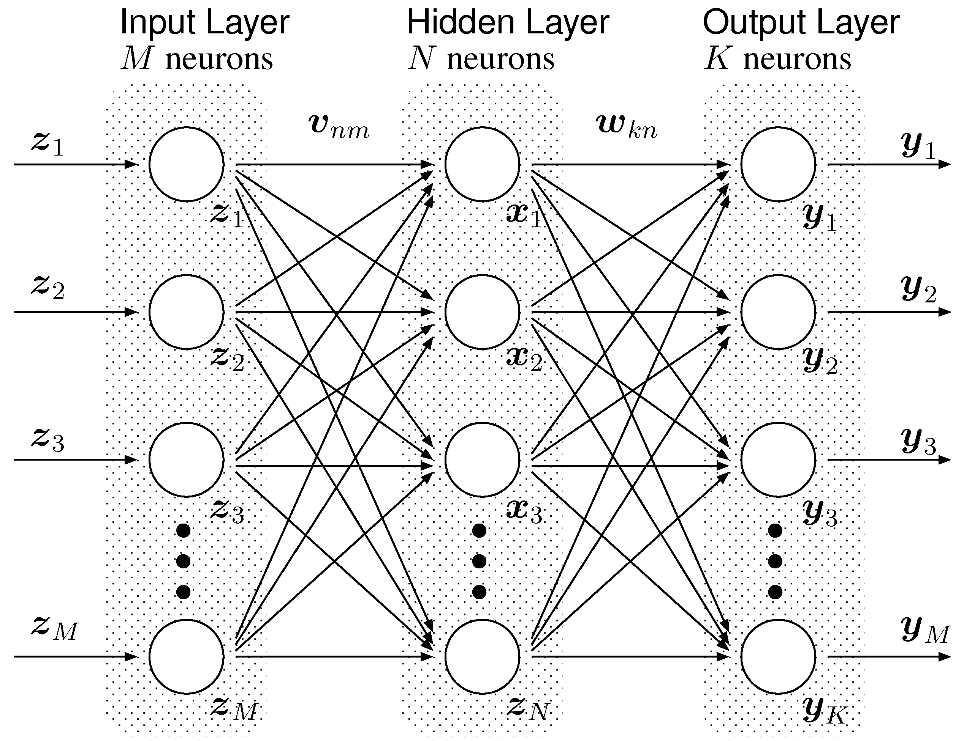
1. Introduction
2. Multi Layer Perceptron
find the weight using back propagation
need large datasets
be aware of overfitting ( many parameters )
https://www.mdpi.com/information/information-03-00756/article_deploy/html/images/information-03-00756-g002.png
Find the best w, b
that best fits the data!

Slide 8
2. Implementation
Karate ( binary classification : Logistic Regression & MLP )
Other data ( multi-class (over 2) classification : OVR )

Slide 9
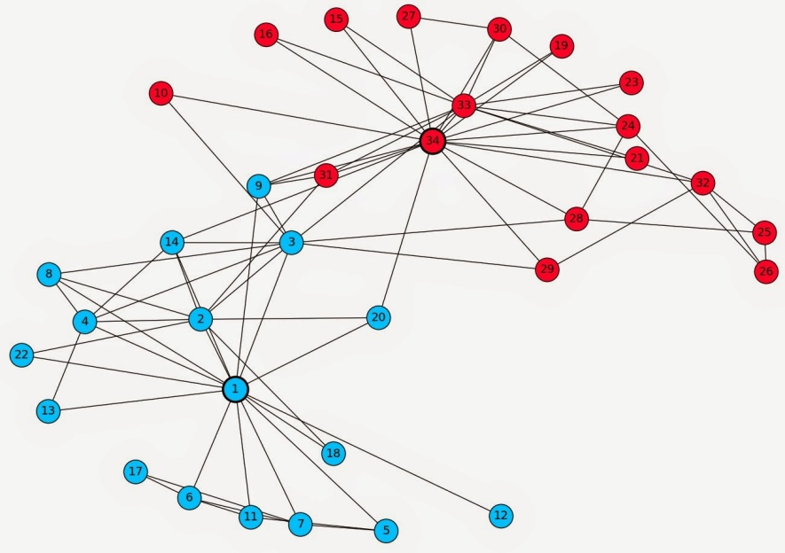
1. Karate Dataset
Import Dataset
Define Functions
Modeling ( 1. Logistic Regression & 2. MLP )
Prediction
Evaluation
https://bookdown.org/omarlizardo/_main/images/karate.jpg

Slide 10
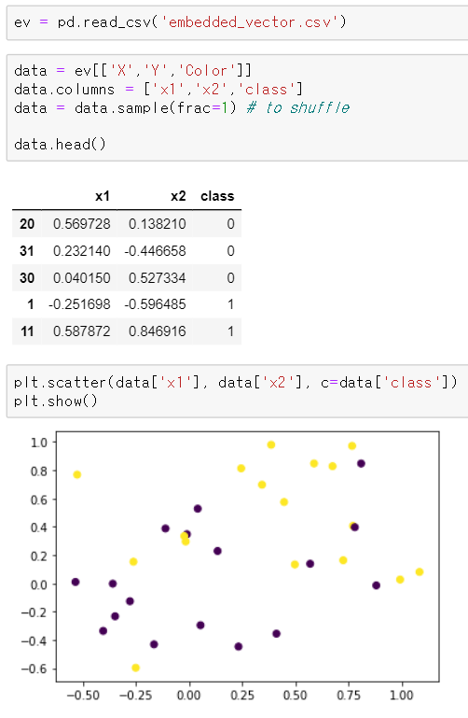
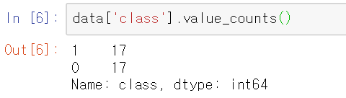

Implementation 1. Karate
1. Import Dataset
Balanced dataset
34 rows, 2 independent variables
Embedded Vector (into 2-dim) of Karate Dataset

Slide 11
Implementation 1. Karate
2. Define Functions
1) train_test_split : divide the dataset into two parts ( train & test )
2) mul : matrix multiplication
3) sigmoid : sigmoid activation function
4) standard_scaler : scale the columns into Gaussian Distribution
5) loss_func : use LogLoss as a loss(cost) function

Slide 12
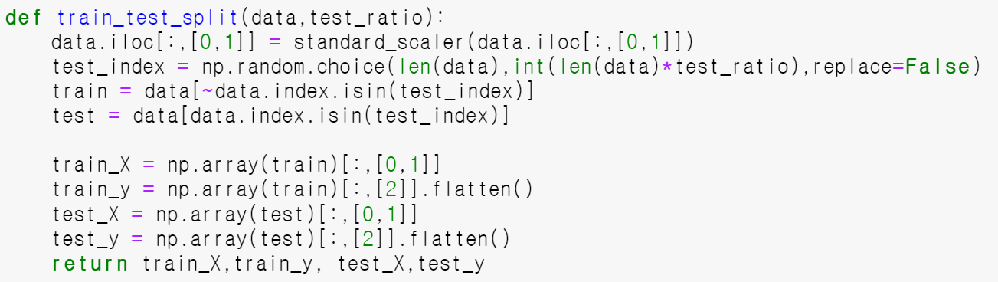
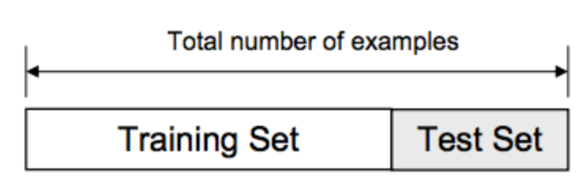
Implementation 1. Karate
2. Define Functions
1) train_test_split
[ process ]
scale every columns ( into Gaussian Distribution )
choose random sample x%
use x% as test dataset, (100-x)%as train dataset
separate X & Y
https://miro.medium.com/max/2272/1*-8_kogvwmL1H6ooN1A1tsQ.png

Slide 13
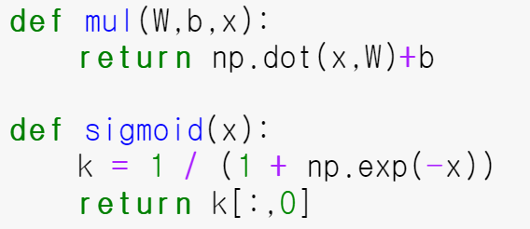
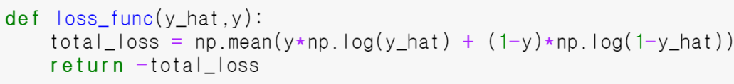
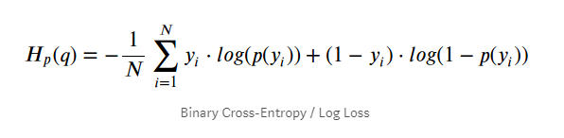
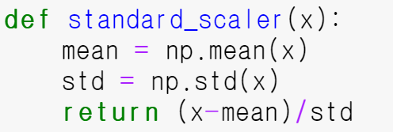
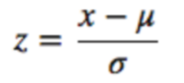
Implementation 1. Karate
2. Define Functions
2) mul & 3) sigmoid
5) loss_fun
4) standard_scaler
use log loss (binary cross entropy) as
a loss function

Slide 14
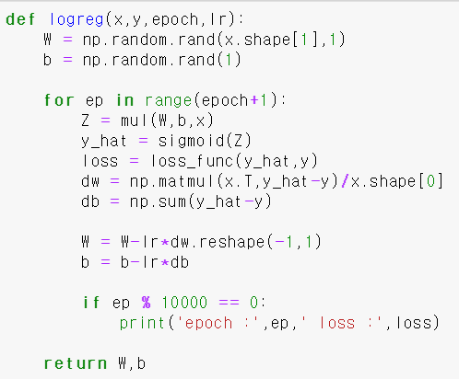
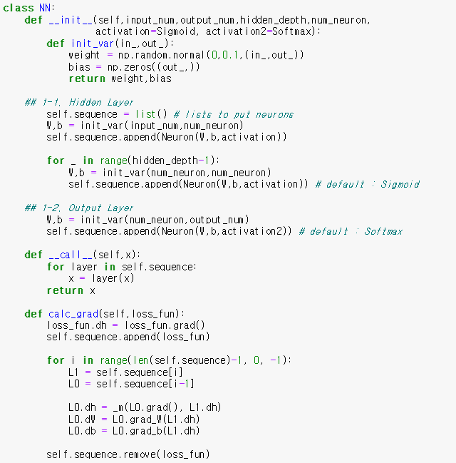
Implementation 1. Karate
3. Modeling
1. Logistic Regression
2. Multi Layer Perceptron

Slide 15
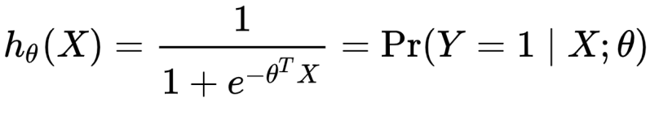
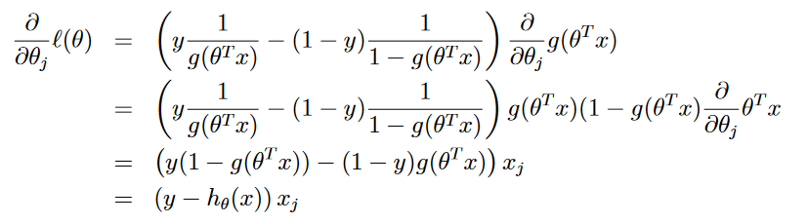
Implementation 1. Karate
3. Modeling
1. Logistic Regression
Multi Layer Perceptron
1. Initialize W & b
2. Find the probability
3. Update weights

Slide 16
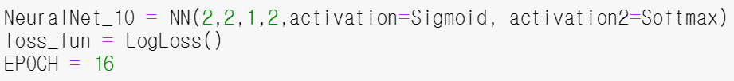
Implementation 1. Karate
3. Modeling
Logistic Regression
2. Multi Layer Perceptron
1. Input :
- number of neurons in input layer
- number of neurons in hidden layer
- number of neurons in output layer
- number of hidden layers
- activation function 1 & 2
2. Network Architecture :
(input)
2D data
(output)
Probability

Slide 17
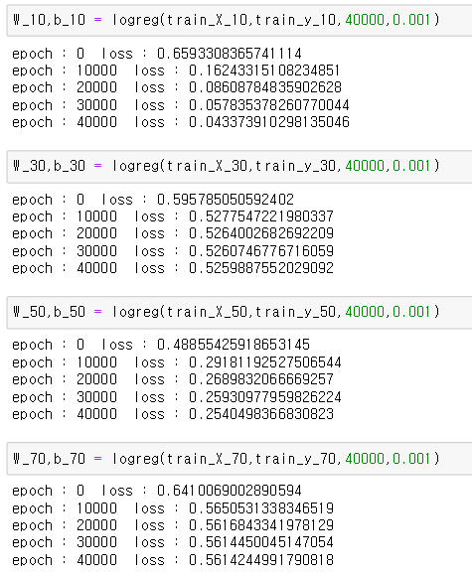
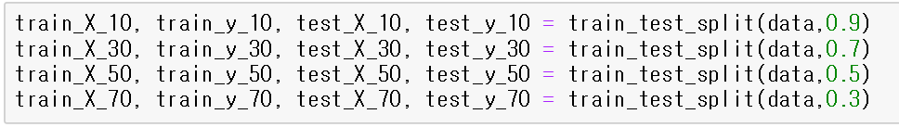
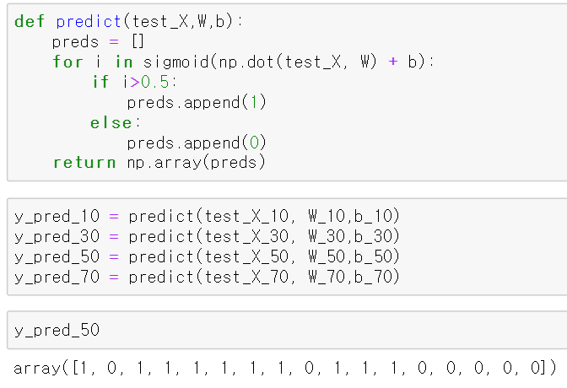
Implementation 1. Karate
4. Prediction
1. Logistic Regression
(2) Train the model
(1) Split the data
10%
(3) Make a prediction based on cut-off value of 0.5
30%
50%
70%

Slide 18
Implementation 1. Karate
4. Prediction
1. Logistic Regression
(2) Train the model
(1) Split the data
10%
(3) Make a prediction based on cut-off value of 0.5
30%
50%
70%

Slide 19
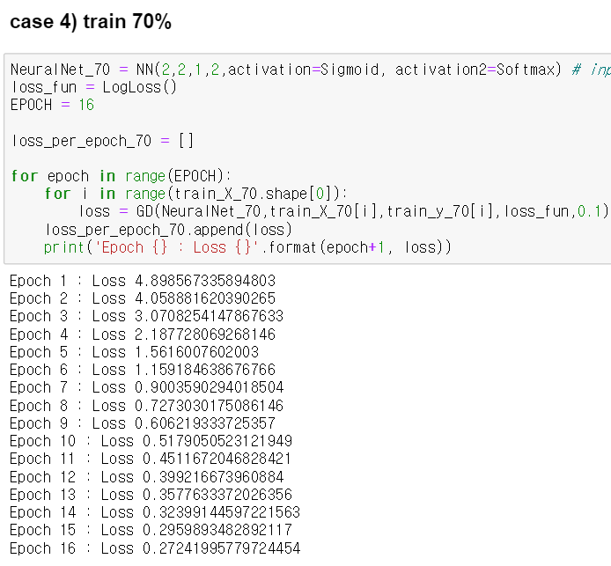
Implementation 1. Karate
4. Prediction
2. Multi Layer Perceptron
(2) Train the model
(1) Split the data
( Same data preprocessing as Logistic Regression )

Slide 20
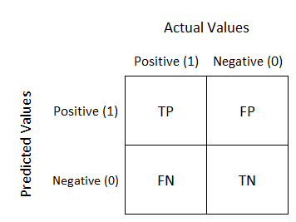
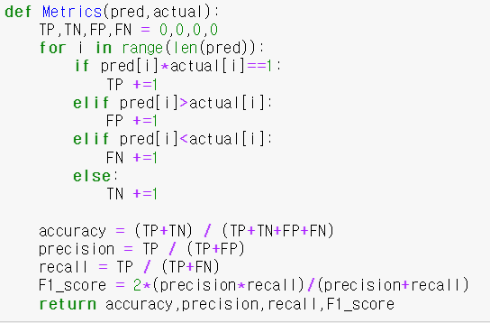
Implementation 1. Karate
5. Evaluation
Return 4 metrics
Accuracy
Precision
Recall
F1-Score

Slide 21
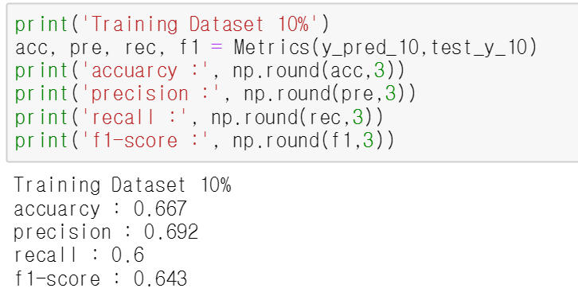
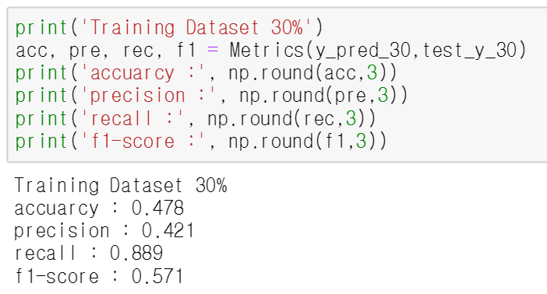
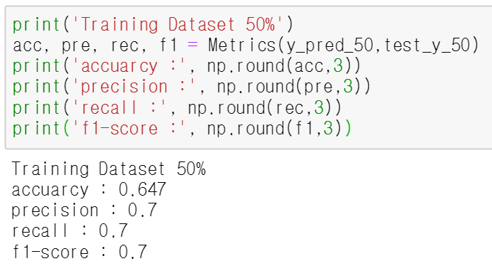
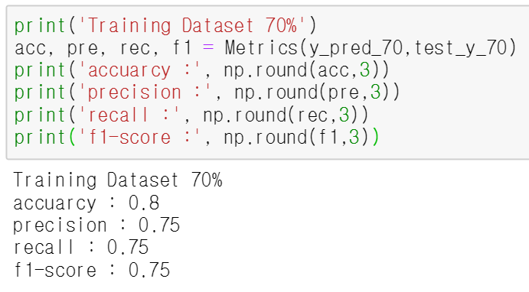
Implementation 1. Karate
5. Evaluation
1. Logistic Regression
10%
30%
50%
70%

Slide 22
Implementation 1. Karate
5. Evaluation
1. Logistic Regression
10%
30%
50%
70%

Slide 23
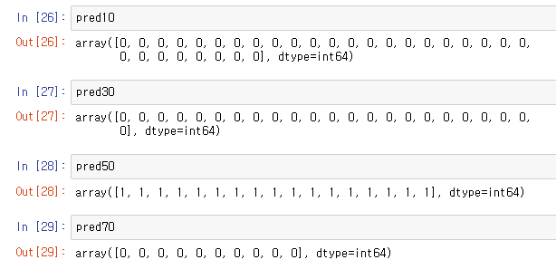
Implementation 1. Karate
5. Evaluation
2. Multi Layer Perceptron
TOO SMALL dataset to be
used on Neural Network!

Slide 24
Implementation 1. Karate
Implication
Too Small Dataset!
Should use most of the data to train the model

Slide 25
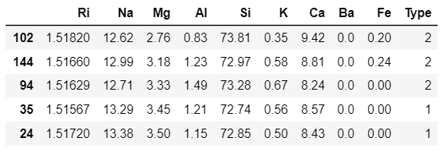
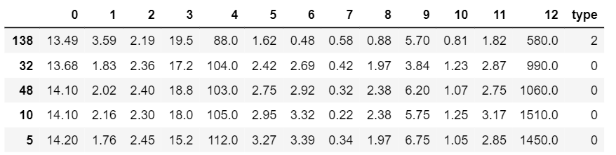
( unable to open BlogCatalog )
2. Other Datasets
[ Glass Dataset ]
- Goal : classify which type the glass belongs to!
- Number of classes : 6
[ Wine Dataset ]
- Goal : classify which type the wine belongs to!
- Number of classes : 3

Slide 26
2. Other Datasets
all the other settings are same as [ 1.Karate ] except…
[ Implementation ]
1. OVR
2. Confusion Matrix
3. F1-Score ( micro & macro )
Binary Classification
Multi-Class Classification
Logistic Regression ( 1 classifier )
OVR (One-Versus-Rest) ( C classifier )

Slide 27
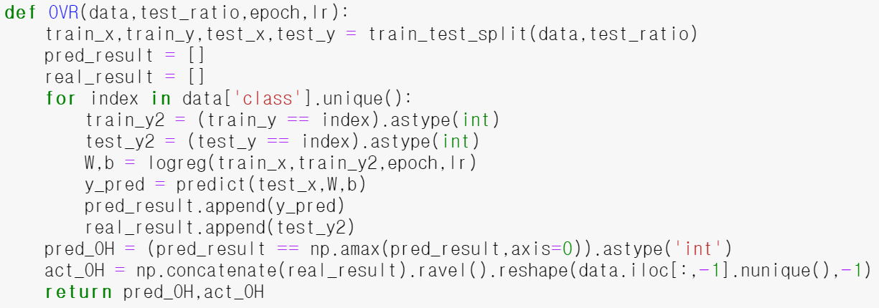
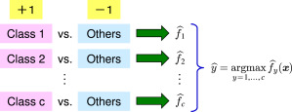
Implementation 1. Karate
1. OVR
(1) Split the dataset
loop ‘C’ times ( C : number of unique classes )
(2) Return 1 if ( class = index ) 0 if ( class! = index )
(3) Modeling & Training & Predicting
(4) Classify according to =>

Slide 28
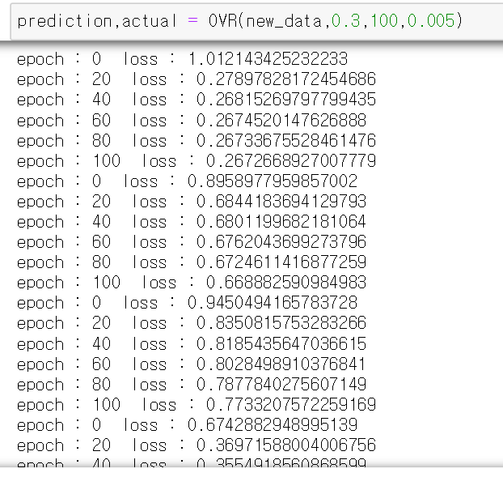
Result
Classifier 1 : [ Class 1 ] vs [ Rest ]
Classifier 2 : [ Class 2 ] vs [ Rest ]
Classifier 3 : [ Class 3 ] vs [ Rest ]
Classifier 4 : [ Class 4 ] vs [ Rest ]

Slide 29
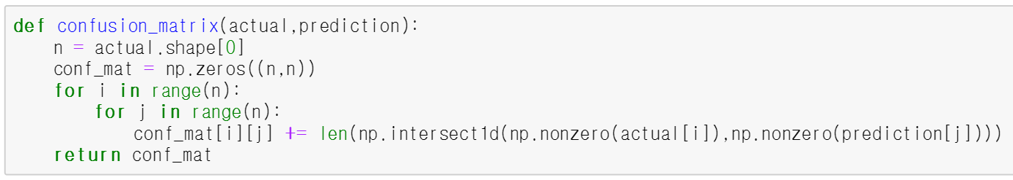
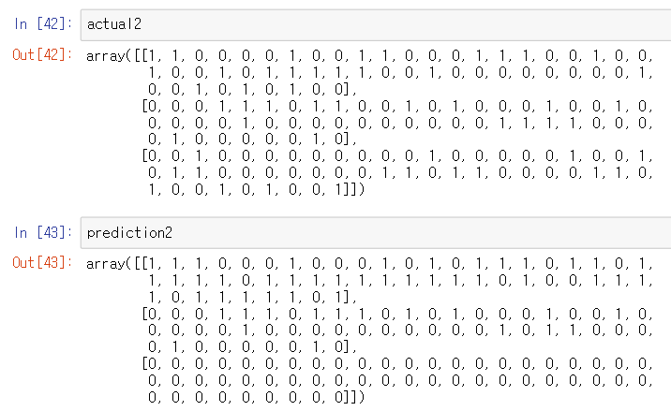
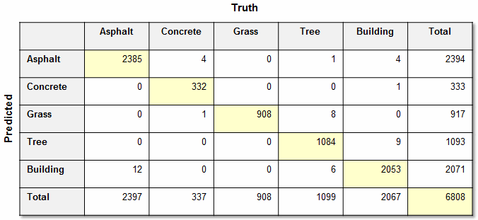
2. Confusion Matrix
Class 1
Class 2
Class 3
Class 1
Class 2
Class 3

Slide 30
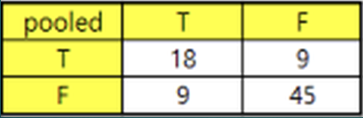
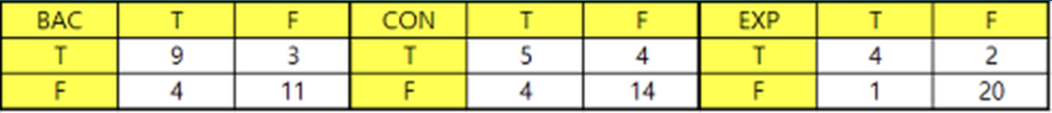
3. F1-Score
Micro
1
weight : number of actual class
2
3
Macro
( average & weighted average )

Slide 31
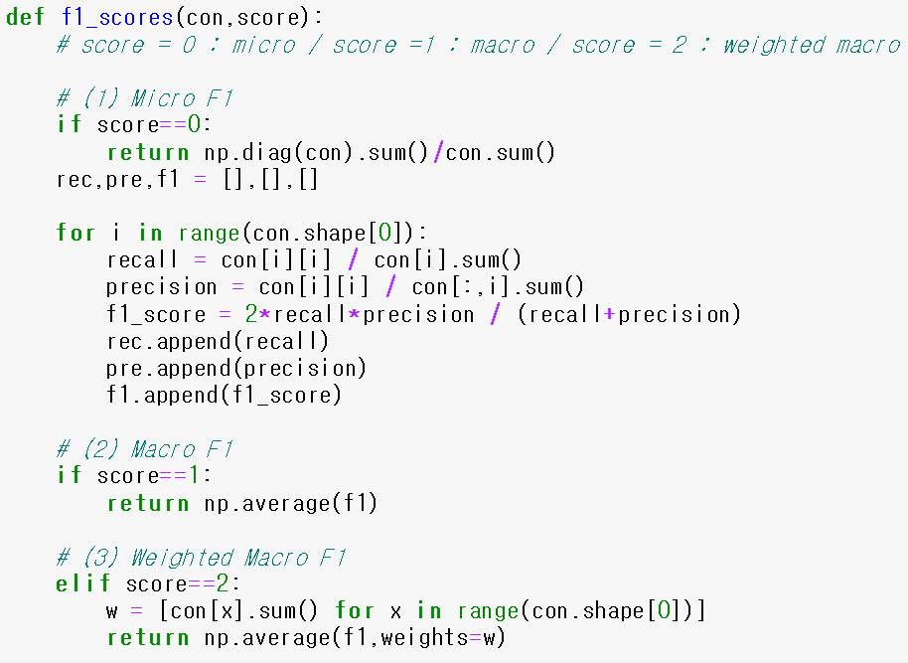
3. F1-Score
1
2
3

Slide 32
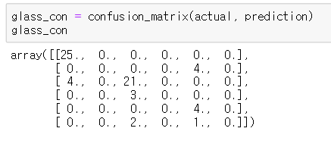
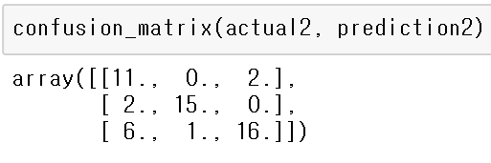
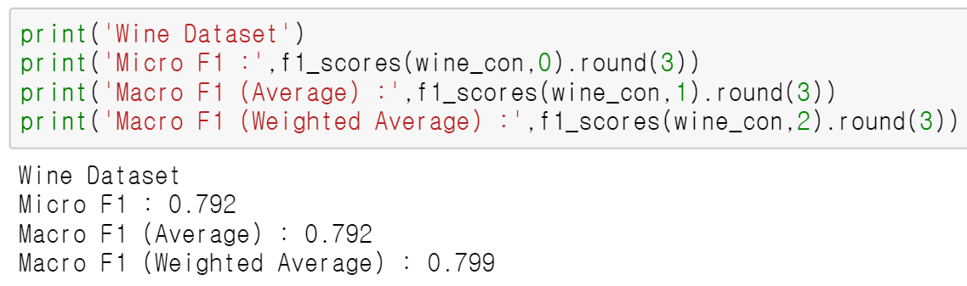
Result
Glass Data
Wine Data
Confusion
matrix
F1-Score

Slide 33
Thank You!!

